Slide 1
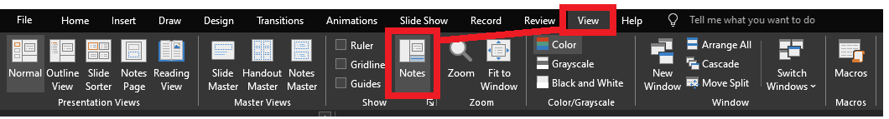
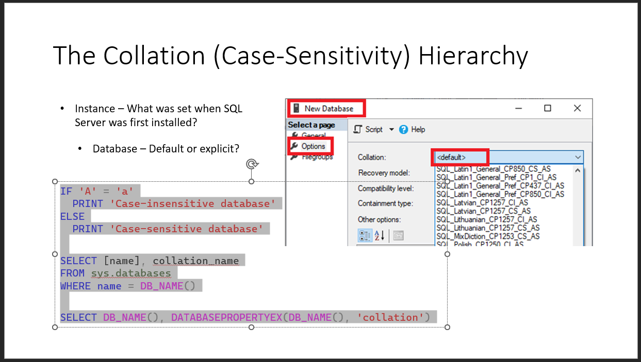
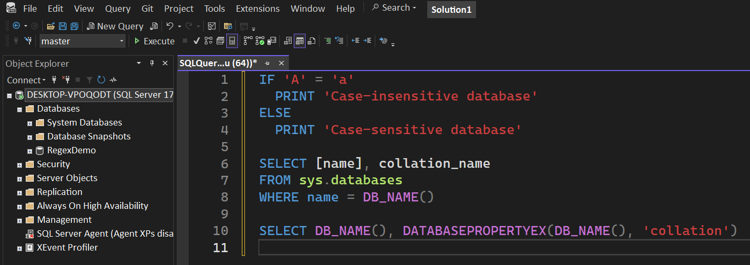
Reviewing after the presentation?
Be sure to enable the Notes for slide-specific content
Slides have working T-SQL that can be copied/pasted into SSMS

Slide 2




Advanced T-SQL Pattern Matching: Leveraging LIKE and Regular Expressions

Slide 3

LIKE REGEXP
Notes:
Microsoft introduced Regular Expressions for Azure SQL and Fabric. You’re probably here for the brand new Regular Expressions.
But are you using LIKE effectively? Do you know all the abilities it has?
Before we go into the new shiny toy, let’s level-set on LIKE, get up-to-speed, then we can compare and contrast the REGEXP operators.

Slide 4


Jeff Foushee
SQL Server Database Admin
Programmer
SQL Saturday speaker
Blackjack dealer

Slide 5
stringable1 LIKE stringable2
SELECT [name], [description]
FROM [SomeTable]
WHERE [description] LIKE ...
“Stringable” refers to anything that can be represented as a string, including numerics, datetimes, guids, etc.

Slide 6

% – Wildcard of any non-NULL length (even zero)
%
LIKE 'A%'
LIKE 'A%B'
(at the end)
(on the inside)
LIKE '%A'
(at the beginning)
LIKE '%B%'
(on the outsides)

Slide 7

%

Slide 8

_
[]
[-]
[^]
%
ESCAPE
Notes:
There are more symbols available to LIKE beyond the % character.
If you don’t know about them, you can’t appreciate them.

Slide 9
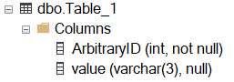
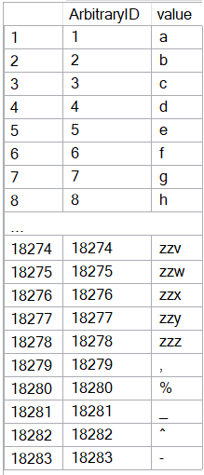
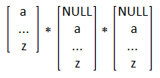
CREATE TABLE dbo.Table_1
( ArbitraryID int IDENTITY(1,1) NOT NULL, [value] varchar(3) )
SET NOCOUNT ON
DECLARE @_text2 varchar(26) = 'abcdefghijklmnopqrstuvwxyz'
DECLARE @_text1 varchar(26) = @_text2
DECLARE @_text0 varchar(26) = @_text1
DECLARE @_p2 tinyint = 0
DECLARE @_p1 tinyint = 0
DECLARE @_p0 tinyint = 0
WHILE 1 = 1
BEGIN
SET @_p2 +=1
IF @_p2 > 26
BEGIN
SET @_p1 += 1
SET @_p2 = 1
END
IF @_p1 > 26
BEGIN
SET @_p0 += 1
SET @_p1 = 1
END
IF @_p0 > 26
BREAK
DECLARE @_text varchar(3) = CONCAT(
SUBSTRING(@_text0, @_p0, 1)
, SUBSTRING(@_text1, @_p1, 1)
, SUBSTRING(@_text2, @_p2, 1) )
INSERT INTO dbo.Table_1 (value) VALUES (@_text)
END
INSERT INTO [dbo].[Table_1] ([value]) VALUES(','), ('%'), ('_'), ('^'), ('-')
INSERT INTO [dbo].[Table_1] ([value]) VALUES(','), ('%'), ('_'), ('^'), ('-')
Notes:
This code will build the sample data used for the demos

Slide 10
_ – Wildcard of one character
Represents a wildcard, like %, but for only one non-NULL character
[] – Containment characters
Represent a non-delimited array of allowable characters as one position
% and _ lose their special wildcard abilities inside the containment characters
NULL/blank are not acceptable entries for this list
Not nestable. [ also loses its special ability inside the containment characters
Notes:
The underscore guarantees a length of one character per underscore requested.
The container characters enclose an array of characters allowed as one character position

Slide 11
Demo
● LIKE – Wildcard _ , containment [] characters

Slide 12
[-] – Range character
Requires the containment characters
Provides a shortcut to consolidate characters on its immediate left and right
Characters must be contiguous; Lower value must be on the left.
[^] – Negation character
Requires the containment characters
Provides a “NOT” to all characters on its right
Must be the FIRST character within the containment characters to take effect

Slide 13
Demo
● LIKE - Range [-], and negation [^]

Slide 14
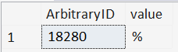
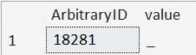
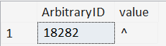
ESCAPE stringable
WHERE [value] LIKE '%\%%' ESCAPE '\'
WHERE [value] LIKE '%%' ESCAPE '%'
WHERE [value] LIKE '%!_%' ESCAPE '!'
WHERE [value] LIKE '%2^%' ESCAPE 2

Slide 15
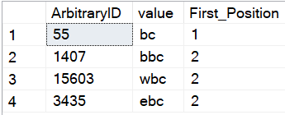
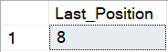
PATINDEX(LIKE_pattern, stringable)
Returns the starting position of the first occurrence of a pattern in a specified expression, or zero if the pattern is not found, on all valid text and character data types.
SELECT TOP 4 ArbitraryID
, [value]
, PATINDEX('%bc', [value]) AS [First_Position]
FROM dbo.Table_1
WHERE [value] LIKE '%bc'
ORDER BY NEWID()
--Find the "last position" using REVERSE()
DECLARE @_value varchar(20) = 'abcdefabcg'
SELECT LEN(@_value)
- PATINDEX(REVERSE('%bc%'), REVERSE(@_value))
AS [Last_Position]

Slide 16
So, like, any questions on LIKE?
Next up, REGEXP_<> functions…
● REGEXP_COUNT()
● REGEXP_LIKE()
● REGEXP_INSTR()
● REGEXP_REPLACE()
● REGEXP_SUBSTR()
● REGEXP_MATCHES()
● REGEXP_SPLIT_TO_TABLE()

Slide 17

Notes:
Regular Expressions is over 70 years old.

Slide 18










Python
JavaScript
Java
C#.NET
Perl
php
Ruby
MySQL
PostgreSQL
Azure SQL DB
Notes:
What is old is new again.

Slide 19
Should I switch to RegEx?
Do I have a compelling reason to switch to RegEx?
Do I have time to learn this complex scripting language?
Notes:
Is this to satisfy a problem that LIKE can’t solve?
Is the effort closing a sizable gap?
Is the strictness an important piece of data integrity?
Unfortunately, I won’t be able to teach you everything in one hour, and your payoff may not be immediate.
Every time you come back to a Regular Expression, you will be spending time re-acclimating yourself with the syntax just to get to the logic.

Slide 20



Should I switch to RegEx?
Do I understand all the business rules well enough to (re-)write them in RegEx?
Which of my teammates can troubleshoot RegEx if I write it?
Office Space, 1999

Slide 21
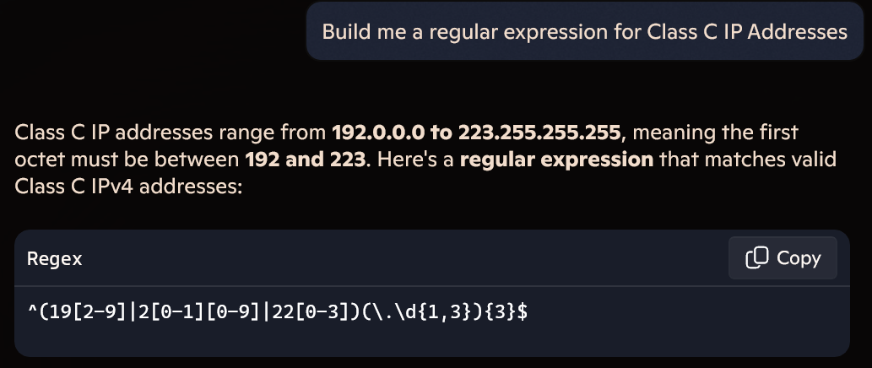
Should I switch to RegEx?
Can I steal a RegEx pattern from the Internet (search or Generative AI)?
Notes:
Generative AI can quickly give a slam-dunk Regex pattern to certain problems.

Slide 22
Should I switch to RegEx?
Can I steal a RegEx pattern from the Internet (search or Generative AI)?
Regular Expression pattern for email address:
^\S+@\S+\.\S+$
^[a-zA-Z0-9_.+-]+@[a-zA-Z0-9-]+\.[a-zA-Z0-9-.]+$
^\w+([-+.']\w+)*@\w+([-.]\w+)*\.\w+([-.]\w+)*$
Notes:
However, in other cases, not even the Internet agrees on an iron-clad solution to a pattern

Slide 23
Mail::RFC822::Address: RegExp-based address validation
(?:(?:\r\n)?[ \t])*(?:(?:(?:[^()<>@,;:\\".\[\] \000-\031]+(?:(?:(?:\r\n)?[ \t])+|\Z|(?=[\["()<>@,;:\\".\[\]]))|"(?:[^\"\r\\]|\\.|(?:(?:\r\n)?[ \t]))*"(?:(?:\r\n)?[ \t])*)(?:\.(?:(?:\r\n)?[ \t])*(?:[^()<>@,;:\\".\[\] \000-\031]+(?:(?:(?:\r\n)?[ \t])+|\Z|(?=[\["()<>@,;:\\".\[\]]))|"(?:[^\"\r\\]|\\.|(?:(?:\r\n)?[\t]))*"(?:(?:\r\n)?[ \t])*))*@(?:(?:\r\n)?[ \t])*(?:[^()<>@,;:\\".\[\] \000-\031]+(?:(?:(?:\r\n)?[ \t])+|\Z|(?=[\["()<>@,;:\\".\[\]]))|\[([^\[\]\r\\]|\\.)*\](?:(?:\r\n)?[ \t])*)(?:\.(?:(?:\r\n)?[ \t])*(?:[^()<>@,;:\\".\[\] \000-\031]+(?:(?:(?:\r\n)?[ \t])+|\Z|(?=[\["()<>@,;:\\".\[\]]))|\[([^\[\]\r\\]|\\.)*\](?:(?:\r\n)?[ \t])*))*|(?:[^()<>@,;:\\".\[\] \000-\031]+(?:(?:(?:\r\n)?[ \t])+|\Z|(?=[\["()<>@,;:\\".\[\]]))|"(?:[^\"\r\\]|\\.|(?:(?:\r\n)?[ \t]))*"(?:(?:\r\n)?[ \t])*)*\<(?:(?:\r\n)?[ \t])*(?:@(?:[^()<>@,;:\\".\[\] \000-\031]+(?:(?:(?:\r\n)?[ \t])+|\Z|(?=[\["()<>@,;:\\".\[\]]))|\[([^\[\]\r\\]|\\.)*\](?:(?:\r\n)?[ \t])*)(?:\.(?:(?:\r\n)?[ \t])*(?:[^()<>@,;:\\".\[\] \000-\031]+(?:(?:(?:\r\n)?[ \t])+|\Z|(?=[\["()<>@,;:\\".\[\]]))|\[([^\[\]\r\\]|\\.)*\](?:(?:\r\n)?[ \t])*))*(?:,@(?:(?:\r\n)?[ \t])*(?:[^()<>@,;:\\".\[\] \000-\031]+(?:(?:(?:\r\n)?[ \t])+|\Z|(?=[\["()<>@,;:\\".\[\]]))|\[([^\[\]\r\\]|\\.)*\](?:(?:\r\n)?[ \t])*)(?:\.(?:(?:\r\n)?[ \t])*(?:[^()<>@,;:\\".\[\] \000-\031]+(?:(?:(?:\r\n)?[ \t])+|\Z|(?=[\["()<>@,;:\\".\[\]]))|\[([^\[\]\r\\]|\\.)*\](?:(?:\r\n)?[ \t])*))*)*:(?:(?:\r\n)?[ \t])*)?(?:[^()<>@,;:\\".\[\] \000-\031]+(?:(?:(?:\r\n)?[ \t])+|\Z|(?=[\["()<>@,;:\\".\[\]]))|"(?:[^\"\r\\]|\\.|(?:(?:\r\n)?[ \t]))*"(?:(?:\r\n)?[ \t])*)(?:\.(?:(?:\r\n)?[ \t])*(?:[^()<>@,;:\\".\[\] \000-\031]+(?:(?:(?:\r\n)?[ \t])+|\Z|(?=[\["()<>@,;:\\".\[\]]))|"(?:[^\"\r\\]|\\.|(?:(?:\r\n)?[ \t]))*"(?:(?:\r\n)?[ \t])*))*@(?:(?:\r\n)?[ \t])*(?:[^()<>@,;:\\".\[\] \000-\031]+(?:(?:(?:\r\n)?[ \t])+|\Z|(?=[\["()<>@,;:\\".\[\]]))|\[([^\[\]\r\\]|\\.)*\](?:(?:\r\n)?[ \t])*)(?:\.(?:(?:\r\n)?[ \t])*(?:[^()<>@,;:\\".\[\] \000-\031]+(?:(?:(?:\r\n)?[ \t])+|\Z|(?=[\["()<>@,;:\\".\[\]]))|\[([^\[\]\r\\]|\\.)*\](?:(?:\r\n)?[ \t])*))*\>(?:(?:\r\n)?[ \t])*)|(?:[^()<>@,;:\\".\[\] \000-\031]+(?:(?:(?:\r\n)?[ \t])+|\Z|(?=[\["()<>@,;:\\".\[\]]))|"(?:[^\"\r\\]|\\.|(?:(?:\r\n)?[ \t]))*"(?:(?:\r\n)?[ \t])*)*:(?:(?:\r\n)?[ \t])*(?:(?:(?:[^()<>@,;:\\".\[\] \000-\031]+(?:(?:(?:\r\n)?[ \t])+|\Z|(?=[\["()<>@,;:\\".\[\]]))|"(?:[^\"\r\\]|\\.|(?:(?:\r\n)?[ \t]))*"(?:(?:\r\n)?[ \t])*)(?:\.(?:(?:\r\n)?[ \t])*(?:[^()<>@,;:\\".\[\] \000-\031]+(?:(?:(?:\r\n)?[ \t])+|\Z|(?=[\["()<>@,;:\\".\[\]]))|"(?:[^\"\r\\]|\\.|(?:(?:\r\n)?[ \t]))*"(?:(?:\r\n)?[ \t])*))*@(?:(?:\r\n)?[ \t])*(?:[^()<>@,;:\\".\[\] \000-\031]+(?:(?:(?:\r\n)?[ \t])+|\Z|(?=[\["()<>@,;:\\".\[\]]))|\[([^\[\]\r\\]|\\.)*\](?:(?:\r\n)?[ \t])*)(?:\.(?:(?:\r\n)?[ \t])*(?:[^()<>@,;:\\".\[\] \000-\031]+(?:(?:(?:\r\n)?[ \t])+|\Z|(?=[\["()<>@,;:\\".\[\]]))|\[([^\[\]\r\\]|\\.)*\](?:(?:\r\n)?[ \t])*))*|(?:[^()<>@,;:\\".\[\] \000-\031]+(?:(?:(?:\r\n)?[ \t])+|\Z|(?=[\["()<>@,;:\\".\[\]]))|"(?:[^\"\r\\]|\\.|(?:(?:\r\n)?[ \t]))*"(?:(?:\r\n)?[ \t])*)*\<(?:(?:\r\n)?[ \t])*(?:@(?:[^()<>@,;:\\".\[\] \000-\031]+(?:(?:(?:\r\n)?[ \t])+|\Z|(?=[\["()<>@,;:\\".\[\]]))|\[([^\[\]\r\\]|\\.)*\](?:(?:\r\n)?[ \t])*)(?:\.(?:(?:\r\n)?[ \t])*(?:[^()<>@,;:\\".\[\] \000-\031]+(?:(?:(?:\r\n)?[ \t])+|\Z|(?=[\["()<>@,;:\\".\[\]]))|\[([^\[\]\r\\]|\\.)*\](?:(?:\r\n)?[ \t])*))*(?:,@(?:(?:\r\n)?[ \t])*(?:[^()<>@,;:\\".\[\] \000-\031]+(?:(?:(?:\r\n)?[ \t])+|\Z|(?=[\["()<>@,;:\\".\[\]]))|\[([^\[\]\r\\]|\\.)*\](?:(?:\r\n)?[ \t])*)(?:\.(?:(?:\r\n)?[ \t])*(?:[^()<>@,;:\\".\[\] \000-\031]+(?:(?:(?:\r\n)?[ \t])+|\Z|(?=[\["()<>@,;:\\".\[\]]))|\[([^\[\]\r\\]|\\.)*\](?:(?:\r\n)?[ \t])*))*)*:(?:(?:\r\n)?[ \t])*)?(?:[^()<>@,;:\\".\[\] \000-\031]+(?:(?:(?:\r\n)?[ \t])+|\Z|(?=[\["()<>@,;:\\".\[\]]))|"(?:[^\"\r\\]|\\.|(?:(?:\r\n)?[ \t]))*"(?:(?:\r\n)?[ \t])*)(?:\.(?:(?:\r\n)?[ \t])*(?:[^()<>@,;:\\".\[\] \000-\031]+(?:(?:(?:\r\n)?[ \t])+|\Z|(?=[\["()<>@,;:\\".\[\]]))|"(?:[^\"\r\\]|\\.|(?:(?:\r\n)?[ \t]))*"(?:(?:\r\n)?[ \t])*))*@(?:(?:\r\n)?[ \t])*(?:[^()<>@,;:\\".\[\] \000-\031]+(?:(?:(?:\r\n)?[ \t])+|\Z|(?=[\["()<>@,;:\\".\[\]]))|\[([^\[\]\r\\]|\\.)*\](?:(?:\r\n)?[ \t])*)(?:\.(?:(?:\r\n)?[ \t])*(?:[^()<>@,;:\\".\[\] \000-\031]+(?:(?:(?:\r\n)?[ \t])+|\Z|(?=[\["()<>@,;:\\".\[\]]))|\[([^\[\]\r\\]|\\.)*\](?:(?:\r\n)?[ \t])*))*\>(?:(?:\r\n)?[ \t])*)(?:,\s*(?:(?:[^()<>@,;:\\".\[\] \000-\031]+(?:(?:(?:\r\n)?[ \t])+|\Z|(?=[\["()<>@,;:\\".\[\]]))|"(?:[^\"\r\\]|\\.|(?:(?:\r\n)?[ \t]))*"(?:(?:\r\n)?[ \t])*)(?:\.(?:(?:\r\n)?[ \t])*(?:[^()<>@,;:\\".\[\] \000-\031]+(?:(?:(?:\r\n)?[ \t])+|\Z|(?=[\["()<>@,;:\\".\[\]]))|"(?:[^\"\r\\]|\\.|(?:(?:\r\n)?[ \t]))*"(?:(?:\r\n)?[ \t])*))*@(?:(?:\r\n)?[ \t])*(?:[^()<>@,;:\\".\[\] \000-\031]+(?:(?:(?:\r\n)?[ \t])+|\Z|(?=[\["()<>@,;:\\".\[\]]))|\[([^\[\]\r\\]|\\.)*\](?:(?:\r\n)?[ \t])*)(?:\.(?:(?:\r\n)?[ \t])*(?:[^()<>@,;:\\".\[\] \000-\031]+(?:(?:(?:\r\n)?[ \t])+|\Z|(?=[\["()<>@,;:\\".\[\]]))|\[([^\[\]\r\\]|\\.)*\](?:(?:\r\n)?[ \t])*))*|(?:[^()<>@,;:\\".\[\] \000-\031]+(?:(?:(?:\r\n)?[ \t])+|\Z|(?=[\["()<>@,;:\\".\[\]]))|"(?:[^\"\r\\]|\\.|(?:(?:\r\n)?[ \t]))*"(?:(?:\r\n)?[ \t])*)*\<(?:(?:\r\n)?[ \t])*(?:@(?:[^()<>@,;:\\".\[\] \000-\031]+(?:(?:(?:\r\n)?[ \t])+|\Z|(?=[\["()<>@,;:\\".\[\]]))|\[([^\[\]\r\\]|\\.)*\](?:(?:\r\n)?[ \t])*)(?:\.(?:(?:\r\n)?[ \t])*(?:[^()<>@,;:\\".\[\] \000-\031]+(?:(?:(?:\r\n)?[ \t])+|\Z|(?=[\["()<>@,;:\\".\[\]]))|\[([^\[\]\r\\]|\\.)*\](?:(?:\r\n)?[ \t])*))*(?:,@(?:(?:\r\n)?[ \t])*(?:[^()<>@,;:\\".\[\] \000-\031]+(?:(?:(?:\r\n)?[ \t])+|\Z|(?=[\["()<>@,;:\\".\[\]]))|\[([^\[\]\r\\]|\\.)*\](?:(?:\r\n)?[ \t])*)(?:\.(?:(?:\r\n)?[ \t])*(?:[^()<>@,;:\\".\[\] \000-\031]+(?:(?:(?:\r\n)?[ \t])+|\Z|(?=[\["()<>@,;:\\".\[\]]))|\[([^\[\]\r\\]|\\.)*\](?:(?:\r\n)?[ \t])*))*)*:(?:(?:\r\n)?[ \t])*)?(?:[^()<>@,;:\\".\[\] \000-\031]+(?:(?:(?:\r\n)?[ \t])+|\Z|(?=[\["()<>@,;:\\".\[\]]))|"(?:[^\"\r\\]|\\.|(?:(?:\r\n)?[ \t]))*"(?:(?:\r\n)?[ \t])*)(?:\.(?:(?:\r\n)?[ \t])*(?:[^()<>@,;:\\".\[\] \000-\031]+(?:(?:(?:\r\n)?[ \t])+|\Z|(?=[\["()<>@,;:\\".\[\]]))|"(?:[^\"\r\\]|\\.|(?:(?:\r\n)?[ \t]))*"(?:(?:\r\n)?[ \t])*))*@(?:(?:\r\n)?[ \t])*(?:[^()<>@,;:\\".\[\] \000-\031]+(?:(?:(?:\r\n)?[ \t])+|\Z|(?=[\["()<>@,;:\\".\[\]]))|\[([^\[\]\r\\]|\\.)*\](?:(?:\r\n)?[ \t])*)(?:\.(?:(?:\r\n)?[ \t])*(?:[^()<>@,;:\\".\[\] \000-\031]+(?:(?:(?:\r\n)?[ \t])+|\Z|(?=[\["()<>@,;:\\".\[\]]))|\[([^\[\]\r\\]|\\.)*\](?:(?:\r\n)?[ \t])*))*\>(?:(?:\r\n)?[ \t])*))*)?;\s*)
6342 characters
https://pdw.ex-parrot.com/Mail-RFC822-Address.html
Notes:
Or the pattern is so ridiculous that it’s not maintainable. This is the Internet Engineering Task Force (IETF) standard for email addresses.

Slide 24
Should I switch to RegEx?
Can I steal a RegEx pattern from the Internet (search or Generative AI)?
(Does the Internet agree on a pattern?)

Slide 25
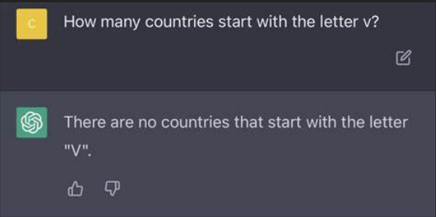
Notes:
Do you trust the answers that Generative AI gives you back?

Slide 26
Should I switch to RegEx?
Can I steal a RegEx pattern from the Internet (search or Generative AI)?
(Does the Internet agree on a pattern?)
(Can I effectively test the pattern that AI gave back to me?)
Notes:
There’s been a big push in programming to let AI take over the code, but no one wants to talk about how
We don’t test enough as it is.
AI answers so definitively, that you might take its answers as absolute fact.

Slide 27

Key Differences between LIKE and REGEXP_<>
A default LIKE search matches the sensitivity of the database collation
A default REGEXP_<> search is case-sensitive,
irrespective of database collation

Slide 28
Key Differences between LIKE and REGEXP_<>
The pattern provided to LIKE implies beginning, middle, end, and length based on the characters given to it
mad
med
mid
mod
mud
WHERE [value] LIKE 'm[aeiou]d'
Implied start Implied end

Slide 29

Key Differences between LIKE and REGEXP_<>
The pattern provided to REGEXP_<> is allowed to appear anywhere in the string to match. Additional directives are applied to specify beginning and end of string.
1. WHERE REGEXP_LIKE([value], 'm[aeiou]d')
2. WHERE REGEXP_LIKE([value], '^m[aeiou]d')
3. WHERE REGEXP_LIKE([value], 'm[aeiou]d$')
+
(Start-of-text character)
(End-of-text character)

Slide 30
Key Differences between LIKE and REGEXP_<>
The pattern provided to REGEXP_<> is allowed to appear anywhere in the string to match. Additional directives are applied to specify beginning and end of string.
Clause 1 | Clause 2 | Clause 3
m[aeiou]d | ^m[aeiou]d | m[aeiou]d$
mad | mad | mad
maddening | maddening | maddening
med | med | med
mid | mid | mid
mod | mod | mod
mud | mud | mud
nomad | nomad | nomad
1. WHERE REGEXP_LIKE([value], 'm[aeiou]d')
2. WHERE REGEXP_LIKE([value], '^m[aeiou]d')
3. WHERE REGEXP_LIKE([value], 'm[aeiou]d$')

Slide 31
The similarities…
Pattern | LIKE | REGEXP
Any one character from a selection | [abc] | [abc]
Any character not in the selection | [^abc] | [^abc]
Any one character in the range | [a-g] | [a-g]
Any numeric in the range | [1-4] | [1-4]

Slide 32
Some transcribed syntax for characters…
Pattern | LIKE | REGEXP
Exactly 1 character (ignoring \n) | _ | .
 |  | .{1}
Any 0+ characters (ignoring \n) | % | .*
 |  | .{0,}
Any 1+ characters (ignoring \n) | _% | .+
 |  | .{1,}
Escaping a symbol | '!_' ESCAPE '!' | \.
“Quantifiers”
Notes:
Quantifiers allow you to build a specific-, a range, an “at-most”, or an “at-least” construct of patterns.

Slide 33
Some transcribed syntax for numerics…
Pattern | LIKE | REGEXP
Exactly 1 numeric | [0-9] | [0-9]
 |  | [0-9]{1}
 |  | \d{1}
Any 0+ numerics | n/a | [0-9]*
 |  | [0-9]{0,}
 |  | \d*
 |  | \d{0,}
Any 1+ numerics | n/a | [0-9]+
 |  | [0-9]{1,}
 |  | \d+
 |  | \d{1,}
“Metacharacters”

Slide 34
Too complex for LIKE…
Pattern | LIKE | REGEXP
Exactly n numeric characters |  | [0-9]{n}
At least n numeric characters |  | [0-9]{n,}
Between n and m numeric characters |  | [0-9]{n,m}
Any one phrase from a selection |  | (oh|on)
Any one phrase, repeated n times |  | (oh|on){n}
Either zero or one lowercase letter |  | [a-z]?

Slide 35
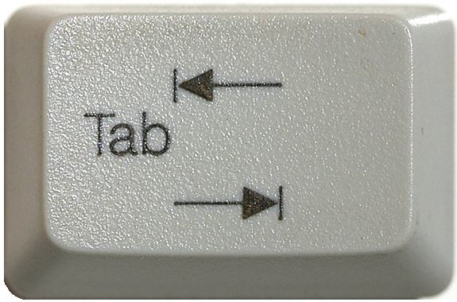

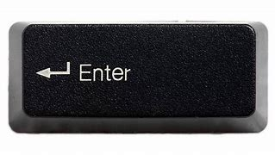
The metacharacters… easier or harder?
([0-9]|[a-zA-Z]|[!@$%&]|[ ]) → .
([0-9]|[a-zA-Z]|[!@$%&]|[ ]) → \d
([0-9]|[a-zA-Z]|[!@$%&]|[ ]) → \D
([0-9]|[a-zA-Z]|[!@$%&]|[ ]) → \w
([0-9]|[a-zA-Z]|[!@$%&]|[ ]) → \W
([0-9]|[a-zA-Z]|[!@$%&]|[ ]) → \s
([0-9]|[a-zA-Z]|[!@$%&]|[ ]) → \S
Newline goes in
this lane, right?
Depends. 🤷❓
Stay tuned for “flags”
Notes:
The period denotes a single character, including the period. Whether or not it includes the newline character depends on “flags,” which will be discussed later.
The “\d” metacharacter stands for the “digit” characters. Capitalizing to “\D” gives the inverse of this list: everything that is not a digit.
The “\w” metacharacter stands for “word” characters. Capitalizing to “\W” includes anything not found in a word
The “\s” metacharacter stands for “whitespace” characters. Capitalizing to “\S” includes anything not considered whitespace.

Slide 36
Basic REGEXP_<> syntax
char,
nchar,
varchar (MAX),
nvarchar (MAX)
<REGEXP_FUNC>(string_or_stringColumn
, RegExPtrn
)
Notes:
All RegExp functions apply to some string and will at least require a Regular Expression pattern.

Slide 37
Basic REGEXP_<> syntax
<REGEXP_FUNC>(string_or_stringColumn
, RegExPtrn
, Param1
, Param2
, flags
, Param4
)
Notes:
All of them will also have one or more additional parameters, but they will have default values

Slide 38
Basic REGEXP_<> syntax
<REGEXP_FUNC>(string_or_stringColumn
, RegExPtrn
[, Param1 = 'default']
[, Param2 = 'default']
[, flags = 'default']
[, Param4 = 'default']
)
Notes:
The way SQL Server designed the function though, is the parameter ordering is very specific, since most of the values are numbers

Slide 39
Basic REGEXP_<> syntax
<REGEXP_FUNC>(string_or_stringColumn
, RegExPtrn
[, Param1 = 'default'
[, Param2 = 'default'
[, flags = 'default'
[, Param4 = 'default'
]
]
]
)
Notes:
You do not have to provide values to any optional default parameters

Slide 40
Basic REGEXP_<> syntax
<REGEXP_FUNC>(string_or_stringColumn
, RegExPtrn
[, Param1 = 'default'
[, Param2 = 'default'
[, flags = 'default'
[, Param4 = 'default'
]
]
]
)
Notes:
But if I want to edit this parameter to a non-default value…

Slide 41
Basic REGEXP_<> syntax
<REGEXP_FUNC>(string_or_stringColumn
, RegExPtrn
, Param1 = 'default'
, Param2 = 'value'
[, flags = 'default'
[, Param4 = 'default'
]
)
Notes:
I have to explicitly request all preceding parameters and values before it, even if I repeat the default value

Slide 42
<REGEXP_FUNC>(stringable, RegExPtrn...[,flags='c'])
Flag | Mode | Description
i | Ignore case | Performs case-insensitive matching.
c | Default | Performs case-sensitive matching. (default)
s | “Dot-all” | Allows the period (.), to match the newline character (\n)
m | Multi-line | ^ and $ match “begin/end line” in addition to “begin/end text”
Notes:
Oracle uses very similarly-named functions. The s-flag is replaced by the n-character in Oracle.

Slide 43
Build some example data
CREATE TABLE dbo.Employees (
ID INT IDENTITY(101,1),
[Name] VARCHAR(150),
Email VARCHAR(320),
Phone_Number VARCHAR(20)
);
INSERT INTO dbo.Employees ([Name], Email, Phone_Number)
VALUES ('John Doe', 'john@contoso.com', '123-456-7890')
, ('Alice Smith', 'alice@fabrikam.com', '234-567-8901')
, ('Bob Johnson', 'bob@fabrikam.net','345-678-9012')
, ('Eve Jones', 'eve@contoso.com', '456-789-0123')
, ('Charlie Brown', 'charlie@contoso.co.in', '567-890-124');
Bad data
https://devblogs.microsoft.com/azure-sql/introducing-regular-expression-regex-support-in-azure-sql-db/

Slide 44
REGEXP_COUNT ( string, RegExPtrn [,startPos = 1 [,flags = 'c']] )
Returns the number of times a regular-expression pattern matches within a string
REGEXP_LIKE(string, RegExPtrn [,flags='c'])
Determines if a string matches a regular expression.
REGEXP_INSTR (string, RegExPtrn [,startPos = 1 [,occurrence = 1
[,return_option = 0 [,flags = 'c']]]] )
From the starting position of some string, find the nᵗʰ occurrence of a Regex pattern, and return its starting/ending position (based on return_option).

Slide 45
Demo
● REGEXP_COUNT()
● REGEXP_LIKE()
● REGEXP_INSTR()
Azure SQL Database (Generally Available)
Azure SQL Managed Instance (Private Preview)
SQL Server 2025 (Public Preview)
SQL Database in Microsoft Fabric (rolling out)

Slide 46
Sub-expressions
SELECT ID, Phone_Number
FROM dbo.Employees
WHERE REGEXP_LIKE(Phone_Number
, '^\d{3}-\d{3}-(9012|0123)$' )
(9012|0123)
Notes:
Earlier while talking about REGEXP_LIKE, we saw the use of parenthesis.
We used them to “wall-off” a list of acceptable values within a certain portion of the pattern.
The pattern contained within parenthesis is called a sub-expression.

Slide 47
Sub-expressions
SELECT ID, Phone_Number
FROM dbo.Employees
WHERE REGEXP_LIKE(Phone_Number
, '^(\d{3})-(\d{3})-(9012|0123)$' )
\1 \2 \3
Notes:
And we can wall-off anything inside a regular expression, even it leaves one option within.

Slide 48
REGEXP_REPLACE ( string, RegExPtrn, withPattern [, startPos = 1 [, occurrence = 0 [, flags = 'c']]] )
Functions supporting sub-expressions
Returns an in-string replacement of one regular expression pattern, with another regular expression pattern.
REGEXP_SUBSTR (string, RegExPtrn [,startPos = 1 [,occurrence = 1
[,flags = 'c' [,whichSubExp = 0]]]] )
Extracts a substring -- matching a regular expression pattern -- found within a string
Notes:
Using REGEXP_REPLACE, we can redecorate data using sub-expressions.
Sub-expressions are numbered based on their creation from left-to-right
SQL Server only supported numbered expressions at this time.
If the data does not meet the criteria of the regular expression, it is returned with no modifications.

Slide 49
Demo
● REGEXP_REPLACE()
● REGEXP_SUBSTR()
Azure SQL Database (Generally Available)
Azure SQL Managed Instance (Private Preview)
SQL Server 2025 (Public Preview)
SQL Database in Microsoft Fabric (rolling out)

Slide 50
REGEXP_MATCHES ( string, RegExPtrn [, flags = 'c'] )
Regex Table-valued Functions (TVFs)
Returns a table of metadata for every occurrence of Regex pattern found within string.
Nothing may be returned if no pattern matches exist.
REGEXP_SPLIT_TO_TABLE ( string, RegExPtrn [, flags = 'c'] )
Returns a table of metadata, each entry delimited from the original string by the pattern.
Everything will be returned in one row if the delimiter pattern is not found.
Notes:
Using REGEXP_REPLACE, we can redecorate data using sub-expressions.
Sub-expressions are numbered based on their creation from left-to-right
SQL Server only supported numbered expressions at this time.
If the data does not meet the criteria of the regular expression, it is returned with no modifications.

Slide 51
Demo
● REGEXP_MATCHES()
● REGEXP_SPLIT_TO_TABLE()
Azure SQL Database (Generally Available)
Azure SQL Managed Instance (Private Preview)
SQL Server 2025 (Public Preview)
SQL Database in Microsoft Fabric (rolling out)

Slide 52
Flags revisited…
Flag | Mode | Description
i | Ignore case | Performs case-insensitive matching.
c | Default | Performs case-sensitive matching. (default)
s | “Dot-all” | Allows the period (.), to match the newline character (\n)
m | Multi-line | ^ and $ match “begin/end line” in addition to “begin/end text”
Notes:
Oracle uses very similarly-named functions. The s-flag is replaced by the n-character in Oracle.

Slide 53
Flags revisited…
Mixed-casing within multi-line
SELECT REGEXP_COUNT('this is a line
This is another line
Third line', '^Thi' [,...]) AS [Count]
Multi-line
Line starts with “Thi”
Flags go here…

Slide 54
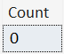
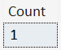
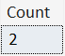
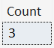
Flags revisited…
SELECT REGEXP_COUNT('this is a line
This is another line
Third line', '^Thi', 1, 'sc') AS [Count]
SELECT REGEXP_COUNT('this is a line
This is another line
Third line', '^Thi', 1, 'si') AS [Count]
SELECT REGEXP_COUNT('this is a line
This is another line
Third line', '^Thi', 1, 'mc') AS [Count]
SELECT REGEXP_COUNT('this is a line
This is another line
Third line', '^Thi', 1, 'mi') AS [Count]

Slide 55
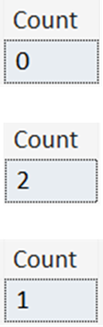
Flags revisited…
SELECT REGEXP_COUNT('Hello World
hello universe
HELLO AGAIN!
hello multi-line match!'
, '^hello.*$', 1, 'sc') AS [Count]
SELECT REGEXP_COUNT('Hello World
hello universe
HELLO AGAIN!
hello multi-line match!'
, '^hello.*$', 1, 'mc') AS [Count]
SELECT REGEXP_COUNT('Hello World
hello universe
HELLO AGAIN!
hello multi-line match!'
, '^hello.*$', 1, 'msc') AS [Count]
Notes:
The m and s flags are not mutually exclusive: they can be combined.

Slide 56

Closing Thoughts…
Developer
DBA

Slide 57
Performance
SELECT [Name], Email, REGEXP_INSTR(email, '@') AS [Position_of_@]
FROM Employees
WHERE REGEXP_INSTR(email, '@') > 0
SELECT [Name], Email, CHARINDEX('@', email ) AS [Position_of_@]
FROM Employees
WHERE Email LIKE '%@%'

Slide 58
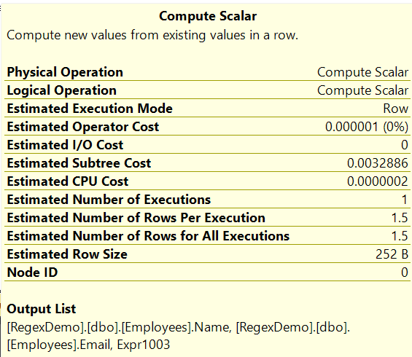
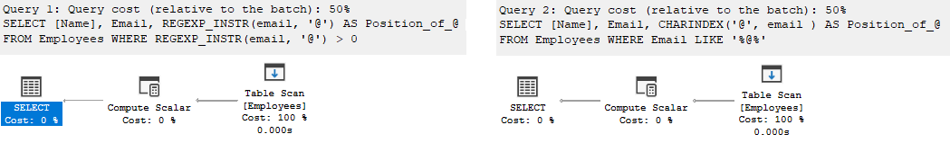
Performance
SELECT [Name], Email, REGEXP_INSTR(email, '@') AS [Position_of_@]
FROM Employees
WHERE REGEXP_INSTR(email, '@') > 0
SELECT [Name], Email, CHARINDEX('@', email ) AS [Position_of_@]
FROM Employees
WHERE Email LIKE '%@%'
Query 1 (relative to the batch): 50% Query 2 (relative to the batch): 50%

Slide 59
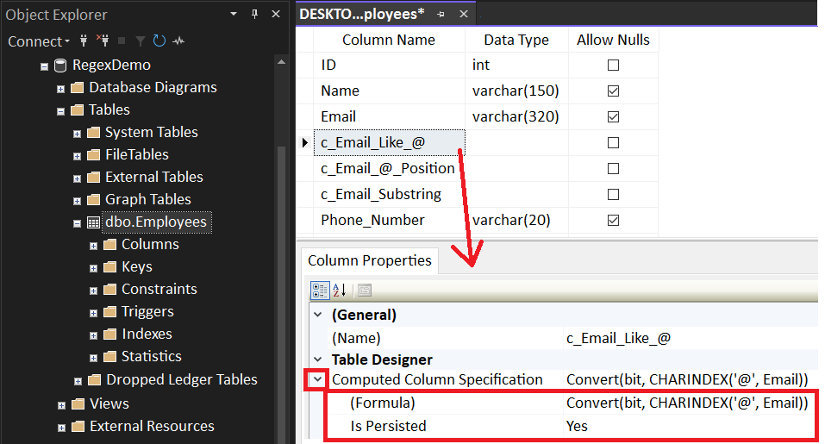
Computed Column
ALTER TABLE dbo.Employees
ADD c_Email_Like_@ AS Convert(bit, CHARINDEX('@', Email)) PERSISTED
, c_Email_@_Position AS CHARINDEX('@', Email) PERSISTED
, c_Email_Substring AS SUBSTRING(Email, 8, 1) PERSISTED

Slide 60
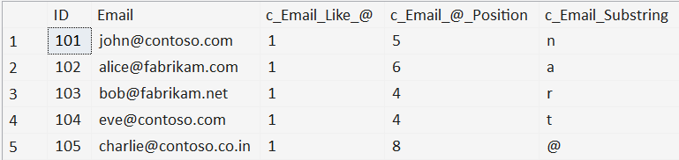
Computed Column
ALTER TABLE dbo.Employees
ADD c_Email_Like_@ AS CONVERT(bit, CHARINDEX('@', Email)) PERSISTED
, c_Email_@_Position AS CHARINDEX('@', Email) PERSISTED
, c_Email_Substring AS SUBSTRING(Email, 8, 1) PERSISTED
SELECT [ID]
, [Email]
, [c_Email_Like_@]
, [c_Email_@_Position]
, [c_Email_Substring]
FROM [dbo].[Employees]
WHERE [c_Email_Like_@] = 1
OR [c_Email_@_Position] > 0
OR [c_Email_Substring] = '@'

Slide 61
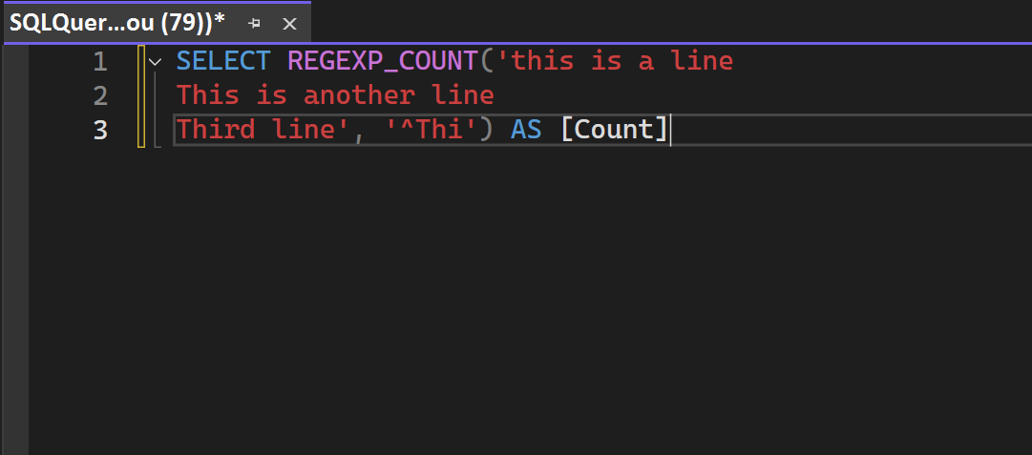
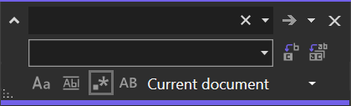
SSMS Find/Replace

Slide 62
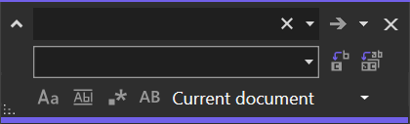
SSMS Find/Replace
(Find box)
(Replace box)
●
Regex Mode: Interprets the Find/Replace boxes as Regular Expression directives

Slide 63



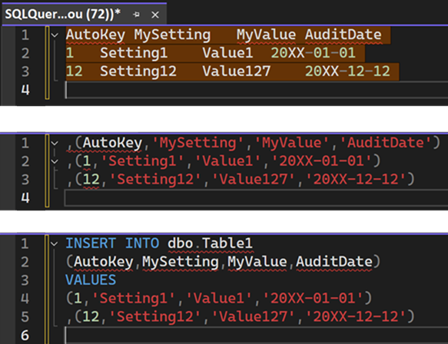
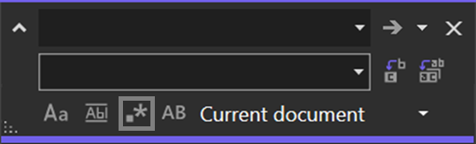
SSMS Find/Replace
^(.*)\t(.*)\t(.*)\t([^\r]*)$
,($1,'$2','$3','$4')
(Minor manual clean-up)
Notes:
$ only matches \n (newline), not \r (carriage return).
Thanks to Erin Stellato at Microsoft for help with this.

Slide 64
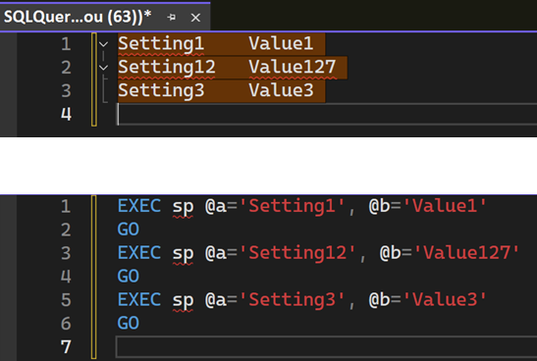
SSMS Find/Replace
^(.*)\t([^\r]*)$
EXEC sp @a='$1', @b='$2'\nGO
Notes:
$ only matches \n (newline), not \r (carriage return).
Thanks to Erin Stellato at Microsoft for help with this.

Slide 65
Demo (if time allows)
SSMS – Find/Replace in Regex Mode

Slide 66
Where do we go from here?
Learned more than just % for LIKE
Scratched the surface on Regular Expression syntax
Introduced to the REGEXP_<> functions
● REGEXP_COUNT()
● REGEXP_LIKE()
● REGEXP_INSTR()
● REGEXP_REPLACE()
● REGEXP_SUBSTR()
● REGEXP_MATCHES()
● REGEXP_SPLIT_TO_TABLE()
Experienced the Regex mode of SSMS Find/Replace

Slide 67


Jeff Foushee
SQL Server Database Admin
Programmer
SQL Saturday speaker
Blackjack dealer
https://www.linkedin.com/in/jeff-foushee/
https://github.com/jbfoushee/MyPresentations/

Slide 68
Advanced T-SQL Pattern Matching: Leveraging LIKE and Regular Expressions
https://github.com/jbfoushee/MyPresentations/

